Slide 1
Convolutional Neural Network
Special kind of neural network for processing data that has know grid-like topology . For example image
1D
CNN
2D
Convolutional
operation
Pooling
FC layers
Why we are not used ANN?
High computational cost
Overfitt
Loss of important feature like spatial arrangement of pixels (distance)

Slide 2
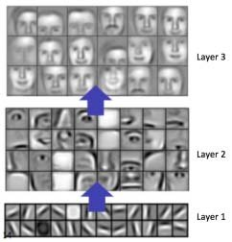
Convolutional Neural Network
Way of CNN works:
CNN find primitive features (Edges) used convoluation operation
Join the feature and extract more primitive feature
FC for final process
More CNN, More complex pattern

Slide 3
Convolutional Neural Network
Example to identify edges
0 | 0 | 0 | 0 | 0 | 0
0 | 0 | 0 | 0 | 0 | 0
0 | 0 | 0 | 0 | 0 | 0
255 | 255 | 255 | 255 | 255 | 255
255 | 255 | 255 | 255 | 255 | 255
255 | 255 | 255 | 255 | 255 | 255
-1 | -1 | -1
0 | 0 | 0
1 | 1 | 1
0 | 0 | 0 | 0
255 | 255 | 255 | 255
255 | 255 | 255 | 255
0 | 0 | 0 | 0
X
=
Image
Filter
Feature map
M x N
K x K
(M-k+1) x (N-k+1)

Slide 4
Convoluational operation
For RGB:
X
=
Image
(6 x 6 x 3)
Filter
(3 x 3 x 3)
Feature map
(4 x 4 x 1)

Slide 5
Convoluational operation
For Mutiple filter:
Vertical edge
X
=
Filter 1
Horizontal edge
X
=
Feature map
(4 x 4 x F)
Filter 2
another edge
X
=
Filter_F
Image
6 x 6 x 3
3 x 3 x 3

Slide 6
Padding
Usd to consist in size
The side of image only one time used in convolutional process
If the pixel value of the side of image is more important we need padding
Image
(5 x 5)
X
=
7 x 7
Padding (2 x 2)
Feature map
(5 x 5)
Filter

Slide 7
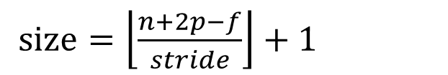
Stride
(Right, Bottm) = (1,1), (2,2)
0 | 0 | 0 | 0 | 0 | 0
0 | 0 | 0 | 0 | 0 | 0
0 | 0 | 0 | 0 | 0 | 0
255 | 255 | 255 | 255 | 255 | 255
255 | 255 | 255 | 255 | 255 | 255
255 | 255 | 255 | 255 | 255 | 255
-1 | -1 | -1
0 | 0 | 0
1 | 1 | 1
i) If we used stride, feature map will be decrease
$size=\left\lfloor \frac{n+2p−f}{stride}\right\rfloor +1$
ii) High level feature need more stride (ignore minor pattern)
iii) Lower computation cost

Slide 8


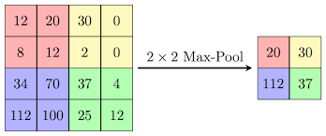
Pooling
Convolution used more memory
Translation variance
Pooling takes three things: size(2,2), strid (2), type (max, min, avg)
Reduce size (Higher-level focus, lower-level ignore)
We need translation invariance:The feature should not depend on location of feature
Enchance features (In max pool)
No need training
Dis:
i) Loss lot of info (4x4 to 2X2 →75% loss information)

